Slide 1
Securing in ASP.NET Core Application

Slide 2
Authentication—The process of determining who made a request.
Authorization—The process of determining whether the requested action is allowed.

Slide 3
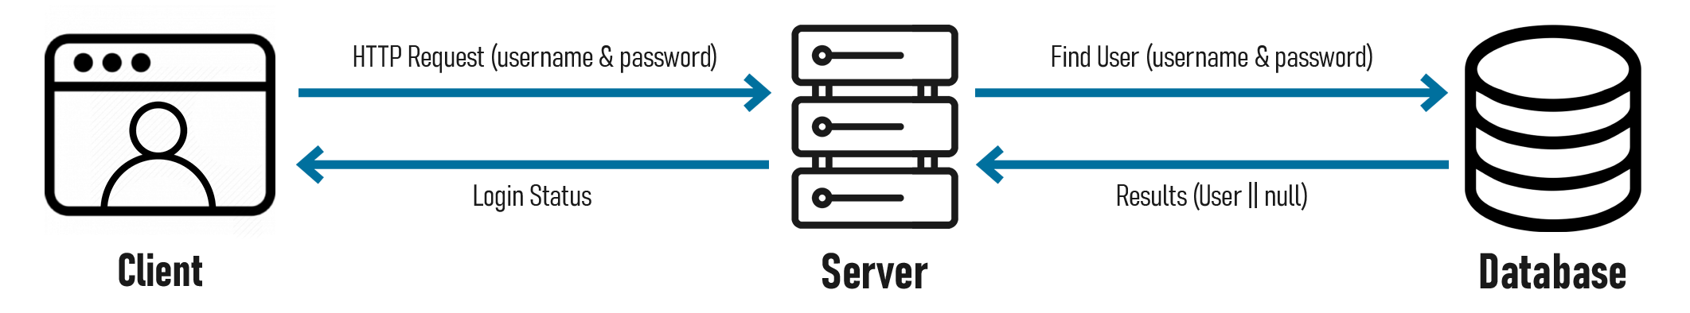
Authentication
Authentication is a process of confirming / recognizing a user’s identity. It is a set of actions, used to verify the user’s credentials against the ones in the database. For the user to be able to provide credentials, An application requires a Login page with a set of fields for the user to interact with.

Slide 4
ASP.NET Core Identity
ASP.NET Core Identity is a membership system which allows you to add login functionality to your application. Users can create an account and login with a user name and password or they can use an external login providers such as Facebook, Google, Microsoft Account, Twitter and more.You can configure ASP.NET Core Identity to use a SQL Server database to store user names, passwords, and profile data. Alternatively, you can use your own persistent store to store data in another persistent storage.
ASP.NET Core Identity:
Is an API that supports user interface (UI) login functionality.
Manages users, passwords, profile data, roles, claims, tokens, email confirmation, and more.

Slide 5
Adding authentication to Apps(CLI)
The quickest way to add authentication to ASP .NET Core App is to use one of the pre-built templates with one of the Authentication options.
None: No authentication
Individual: Individual authentication
IndividualB2C: Individual authentication with Azure AD B2C
SingleOrg: Organizational authentication for a single tenant
MultiOrg: Organizational authentication for multiple tenants
Windows: Windows authentication
The CLI Commands for MVC, Razor Pages and Blazor (Server), respectively:
> dotnet new mvc --auth Individual -o MVCDemo
> dotnet new webapp --auth Individual -o PageDemo
> dotnet new blazorserver --auth Individual -o BlazorDemo
The dotnet new command is followed by the template name (mvc, webapp, blazorserver).
The –auth option allows you to specify the authentication type, e.g. Individual
The -o option is an optional parameter that provides the output folder name for the project to be created in.

Slide 6
Create a Web App with Authentication
Create an ASP.NET Core Web Application project with Individual User Accounts.
Select File > New > Project.
Select ASP.NET Core Web Application. Name the project DemoApp to have the same namespace as the project download. Click OK.
Select an ASP.NET Core Web Application, then select Change Authentication.
Select Individual User Accounts and click OK.
The generated project provides ASP.NET Core Identity as a Razor Class Library. The
Identity Razor Class Library exposes endpoints with the Identity area. For example:
/Identity/Account/Login
/Identity/Account/Logout
/Identity/Account/Manage

Slide 7
Install required packages listed below.
Microsoft.AspNetCore.Identity.EntityFrameworkCore
Microsoft.EntityFrameworkCore
Microsoft.EntityFrameworkCore.SqlServer
Microsoft.EntityFrameworkCore.Tools
Configure Connection inside appsettings.json file
"ConnectionStrings": {
"default": "Data Source=DESKTOP\\SQLEXPRESS;Initial Catalog=DemoApp;Integrated Security=True;Connect Timeout=30;Encrypt=False;TrustServerCertificate=False;ApplicationIntent=ReadWrite;MultiSubnetFailover=False"
}

Slide 8
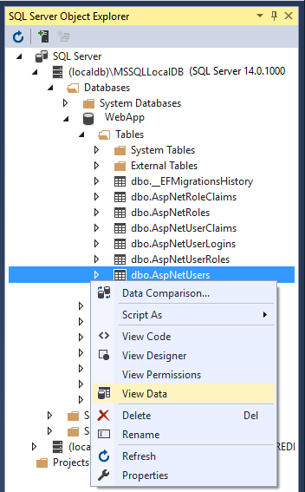
Apply migrations
Apply the migrations to initialize the database.
Run the following command in the Package Manager Console (PMC):
PM> Update-Database
Test Register and Login
Run the app and register a user. Depending on your screen
size, you might need to select the navigation toggle button
to see the Register and Login links.
View the Identity database
From the View menu, select SQL Server Object Explorer
(SSOX).
Navigate to (localdb)MSSQLLocalDB(SQL Server 14).
Right-click on dbo.AspNetUsers > View Data:

Slide 9
Identity service configurations
Services are added in ConfigureServices method in the startup class. The typical
pattern is to call all the Add{Service} methods, and then call all the services.Configure{Service}
methods.
public void ConfigureServices(IServiceCollection services)
{
services.AddDbContext<DemoAppDbContext>(options =>
{
options
.UseSqlServer(Configuration.GetConnectionString("DefaultConnection"),
assembly =>
assembly.MigrationsAssembly
(typeof(DemoAppDbContext).Assembly.FullName));
});
services.AddDefaultIdentity<IdentityUser>(options => options.SignIn.RequireConfirmedAccount = true)
.AddEntityFrameworkStores<DemoAppDbContext>();
}

Slide 10
Identity is enabled by calling UseAuthentication. UseAuthentication adds authentication
middleware to the request pipeline.
public void Configure(IApplicationBuilder app, IWebHostEnvironment env)
{
.....
app.UseHttpsRedirection();
app.UseStaticFiles();
app.UseRouting();
app.UseAuthentication();
app.UseAuthorization();
app.UseEndpoints(endpoints =>
{
endpoints.MapRazorPages();
});
}
The template-generated app doesn't use authorization. app.UseAuthorization is included to ensure it's added in the correct order should the app add authorization. UseRouting, UseAuthentication, UseAuthorization, and UseEndpoints must be called in the order shown in the preceding code.

Slide 11
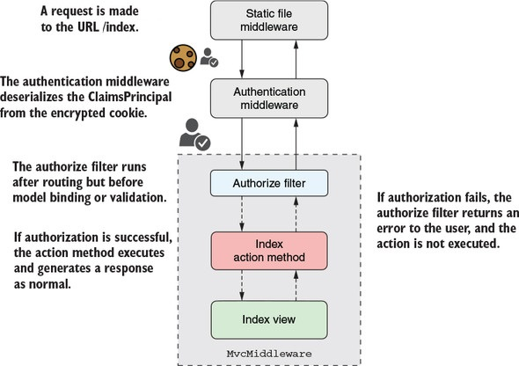
Authorization
The ASP.NET Core framework has authorization built in, so you can use it anywhere in your app, but it’s most common to apply authorization as part of MVC. For both traditional web apps and web APIs, users execute actions on your controllers. Authorization occurs before these actions execute, as shown in figure, This lets you use different authorization requirements for different action methods.

Slide 12
Authorization occurs as part of MvcMiddleware, after AuthenticationMiddeware has
authenticated the request.Authorization occurs as part of the MVC filter pipeline, in
the authorization filters.
When you think about authorization, you typically think about checking whether a particular user has permission to execute an action. In ASP.NET Core, you’d achieve this by checking whether a user has a particular claim.
To achieve basic level of authorization by using the [Authorize] attribute, You can apply this attribute to your actions, as shown in the following listing, to restrict them to authenticated (logged-in) users only. If an unauthenticated user tries to execute an action protected with the [Authorize] attribute in this way, they’ll be redirected to the login page.
public class HomeController : Controller
{
public IActionResult Index()
{
return View();
}
[Authorize]
public IActionResult AuthedUsersOnly()
{
return View();
}
}

Slide 13
Authorization: Roles, Claims and Policies
When an identity is created it may belong to one or more roles. For example, Tracy may belong to the Administrator and User roles whilst Scott may only belong to the User role. How these roles are created and managed depends on the backing store of the authorization process. Roles are exposed to the developer through the IsInRole method on the ClaimsPrincipal class.

Slide 14
Role
Role-based authorization checks are declarative—the developer embeds them within their code, against a controller or an action within a controller, specifying roles which the current user must be a member of to access the requested resource.
For example, the following code limits access to any actions on the
AdministrationController to users who are a member of the Administrator role:
[Authorize(Roles = "Administrator")]
public class AdministrationController : Controller
{
}
You can specify multiple roles as a comma separated list:
[Authorize(Roles = "HRManager,Finance")]
public class SalaryController : Controller
{
}
This controller would be only accessible by users who are members of the HRManager role or the Finance role.

Slide 15
If you apply multiple attributes then an accessing user must be a member of all the roles specified; the following sample requires that a user must be a member of both the Employee and Teacher role.
[Authorize(Roles = “Employee")]
[Authorize(Roles = “Teacher")]
public class ReportController : Controller
{
}
You can further limit access by applying additional role authorization attributes at the action level
[Authorize(Roles = "Parent, Teacher")]
public class ProgressReportController : Controller
{
public ActionResult View()
{
}
[Authorize(Roles = "Teacher")]
public ActionResult Download()
{
}
}

Slide 16
In the previous code snippet members of the Parent role or the Teacher role can access the controller and the view action, but only members of the Teacher role can access the download action.
You can also lock down a controller but allow anonymous, unauthenticated access to individual actions.
[Authorize]
public class TimeTableController : Controller
{
[AllowAnonymous]
public ActionResult View()
{
}
[Authorize(Roles = "Teacher")]
public ActionResult Download()
{
}
}

